Slide 1

Abstract Data Types(ADT).Arrays: Single and Multidimensional Arrays
Data Structure | Introduction to Data Structure
Course: Data Structure | Chapter: Introduction to Data Structure | Program: Bachelor of Engineering
DISCOVER · LEARN · EMPOWER
Notes:
Welcome everyone to today's session on Data Structures. We will focus specifically on Abstract Data Types and the fundamental array structures. Remember, mastering these basics is crucial for solving complex engineering problems later. Let us begin our journey into efficient data organization.

Slide 2
Course Outcomes
SLIDE 2 / 10
Course Outcome
CO | BT LEVEL | DESCRIPTION
CO1 | BT1 | Understand and apply basic data structures, algorithms, complexity analysis, ADTs, arrays and linked lists.
CO2 | BT2 | Apply and implement stacks and queues in problem-solving.
CO3 | BT3 | Analyse and apply searching, sorting, and hashing techniques.
CO4 | BT4 | Construct and apply tree structures and traversal techniques.
CO5 | BT5 | Represent and solve graph problems using DFS, BFS, and graph algorithms.
Chandigarh University
2 / 10
Notes:
Today's lecture directly addresses CO1 by deepening your understanding of ADTs and arrays. While CO5 focuses on graphs, the array concepts we learn here form the underlying storage mechanism for graph adjacency matrices. Both outcomes rely on your ability to manipulate these fundamental structures efficiently.

Slide 3
Learning Objectives
SLIDE 3 / 10
Learning Outcomes
1
Analyze the definition and characteristics of Abstract Data Types in programming.
2
Evaluate the memory allocation strategies for single-dimensional arrays.
3
Differentiate between row-major and column-major storage for multidimensional arrays.
4
Calculate memory addresses for specific elements in 2D array structures.
5
Apply array indexing rules to solve real-world data storage problems.
Chandigarh University
3 / 10
Notes:
By the end of this session, you will be able to analyze how ADTs define behavior without implementation details. You will evaluate how memory is allocated for arrays and differentiate between storage orders. We will also calculate specific memory addresses to ensure you understand the underlying mechanics.

Slide 4
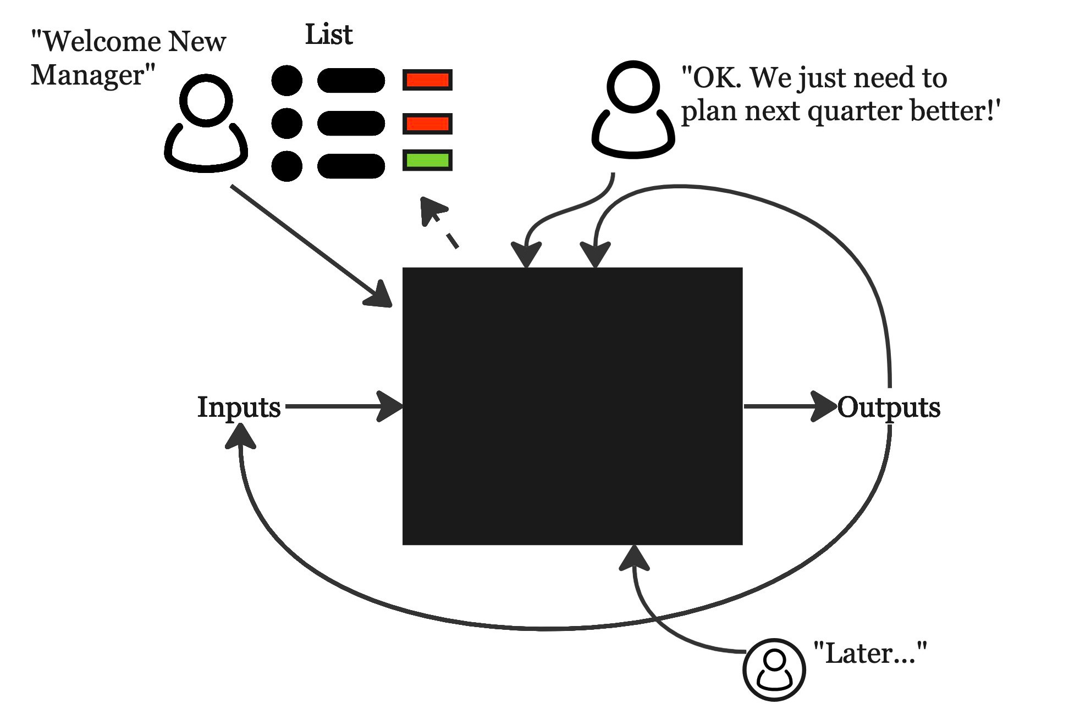
Lecture
SLIDE 4 / 10
Abstract Data Types Definition
1
An ADT defines a set of data and operations without specifying implementation details.
2
It separates the logical properties of data from the physical storage mechanism.
3
Common examples include Stack, Queue, List, and the Array structure itself.
4
Users interact with ADTs through defined operations like insert, delete, and search.
5
Implementation allows the same ADT to be built using arrays or linked lists.
TBM 224: The Black Box - by John Cutler
Chandigarh University
4 / 10
Notes:
Think of an ADT as a contract between the user and the programmer. You know what a Stack does—push and pop—but not how it stores data internally. This abstraction allows us to change the underlying array implementation without breaking the code that uses the Stack.

Slide 5
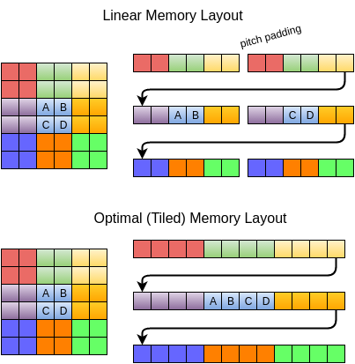
Lecture
SLIDE 5 / 10
Single Dimensional Arrays
EXAMPLE
int scores[5] stores five integers in consecutive memory locations.
• A single array stores a contiguous block of elements of the same data type.
• Each element is accessed using a unique integer index starting from zero.
• Memory allocation is static, meaning the size must be defined before execution.
• Access time is constant O(1) because the address is calculated directly.
Source: stevengong.co
Chandigarh University
5 / 10
Notes:
Imagine a row of lockers where each locker holds a student's score. If you know the starting address and the size of each locker, you can find any score instantly. This is why arrays are so fast for random access compared to other structures.

Slide 6
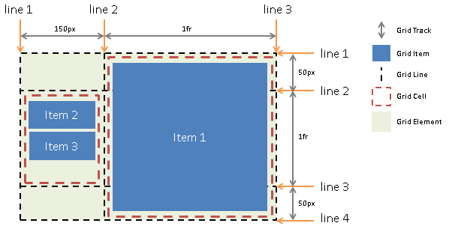
Lecture
SLIDE 6 / 10
Multidimensional Arrays Basics
ELEMENTS ARE ACCESSED USING TWO INDICES
array[row][column].
• Multidimensional arrays extend the concept to store data in rows and columns.
• A 2D array is essentially an array of arrays with row and column indices.
• They are ideal for representing matrices, grids, and tabular data structures.
• Declaration requires specifying the number of rows and columns explicitly.
Source: www.w3.org
Chandigarh University
6 / 10
Notes:
If a single array is a row of lockers, a 2D array is a whole building with multiple floors and rooms. You need two coordinates to find a specific item, just like an address on a map. This structure is fundamental for representing matrices in engineering calculations.

Slide 7
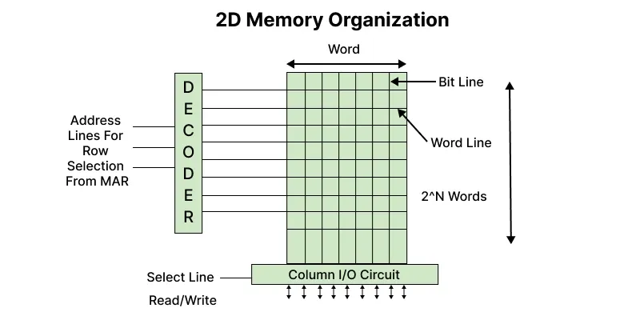
Memory Mapping
SLIDE 7 / 10
Row-Major Order
GOVERNING EQUATION
Formula: Address = Base + (i × N + j) × Size
N is columns.
1
Row-major order stores all elements of the first row before the second.
2
It is the default storage method used by C, C++, and Java languages.
3
The address of an element is calculated based on the row index first.
4
Accessing elements sequentially in a row is faster due to cache locality.
Source: media.geeksforgeeks.org
Chandigarh University
7 / 10
Notes:
In row-major order, the computer fills the first row completely before moving to the next. This is like reading a book line by line. If you access elements in the same row, the processor can load them quickly into the cache, making operations faster.

Slide 8
Memory Mapping
SLIDE 8 / 10
Column-Major Order
GOVERNING EQUATION
Formula: Address = Base + (j × M + i) × Size
M is rows.
1
Column-major order stores all elements of the first column before the second.
2
It is the default storage method used by Fortran and MATLAB languages.
3
The address of an element is calculated based on the column index first.
4
Accessing elements sequentially in a column is faster in this layout.
Source: media.geeksforgeeks.org
Chandigarh University
8 / 10
Notes:
Contrast this with column-major order, where the computer fills the first column completely before moving to the next. This is like reading a newspaper column by column. If your algorithm processes data column-wise, this layout can significantly improve performance.

Slide 9
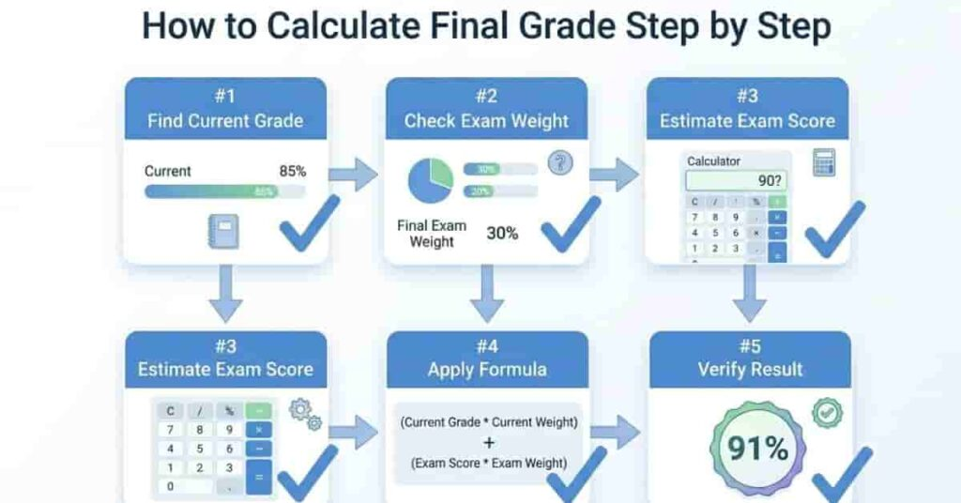
Lecture
SLIDE 9 / 10
Address Calculation Example
GOVERNING EQUATION
Formula: Address = Base + (i × N + j) × Size
SUBSTITUTION
1000 + (2 × 4 + 3) × 4 = 1000 + 11 × 4.
RESULT
The memory address of A[2][3] is 1044 bytes.
• Given int A[3][4] with base address 1000 and element size 4 bytes.
• Calculate the address of element A[2][3] using row-major order.
Source: classrankcalculator.com
Chandigarh University
9 / 10
Notes:
Let's work through a concrete example. If we have a 3x4 matrix starting at address 1000, finding the element at row 2, column 3 requires a simple calculation. We multiply the row index by the number of columns, add the column index, and multiply by the element size. This gives us the exact memory location 1044.

Slide 10
Lecture
SLIDE 10 / 10
References
DATA STRUCTURES
A Pseudocode Approach with C — Gilberg, Forouzan
• Data Structures — Lipschutz
• Data Structure Using C — AK Sharma
• C and Data structure — P. S. Deshpandey
Chandigarh University
10 / 10
Notes:
These four textbooks provide comprehensive coverage of the topics we discussed today. I recommend Gilberg and Forouzan for their pseudocode approach, which helps in understanding logic before coding. Lipschutz and Sharma offer excellent C-specific implementations for practical application. Please refer to these for deeper study and practice problems.

